Slide 1
DESIGN AND ANALYSIS OF ALGORITHMS
Dr Tathagata Ray, BITS- Pilani

Slide 2
Graph Algorithms
Representation of Graphs

Slide 3
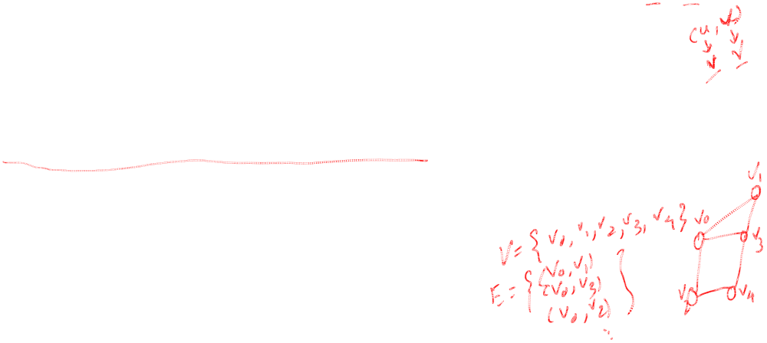
Definition of Graphs
A graph is a finite set of nodes with edges between nodes
Formally, a graph G is a structure (V,E) consisting of
  a finite set V called the set of nodes, and
  a set E that is a subset of VxV. That is, E is a set of pairs of the form (x,y) where x and y are nodes in V

Slide 4

Graph Representation
For graphs to be computationally useful, they have to be conveniently represented in programs
There are two computer representations of graphs:
  Adjacency matrix representation
  Adjacency lists representation

Slide 5
Adjacency Matrix Representation
In this representation, each graph of n nodes, (without parallel edges) is represented by an n x n matrix A, that is, a two-dimensional array A
The nodes are (re)-labeled 1,2,…,n
A[i][j] = 1 if (i, j) is an edge
A[i][j] = 0 if (i ,j) is not an edge

Slide 6
Pros and Cons of Adjacency Matrices
Pros:
  Simple to implement
  Easy and fast to tell if a pair (i,j) is an edge: simply check if A[i][j] is 1 or 0
Cons:
  No matter how few edges the graph has, the matrix takes O(n²) in memory

Slide 7
Adjacency Lists Representation
A graph of n nodes is represented by a one-dimensional array L of linked lists, where
  L[i] is the linked list containing all the nodes adjacent from node i.
  The nodes in the list L[i] are in no particular order

Slide 8
Pros and Cons of Adjacency Lists
Pros:
  Saves on space (memory): the representation takes as many memory words as there are nodes and edge.
Cons:
  It can take up to O(n) time to determine if a pair of nodes (i,j) is an edge: one would have to search the linked list L[i], which takes time proportional to the length of L[i].

Slide 9
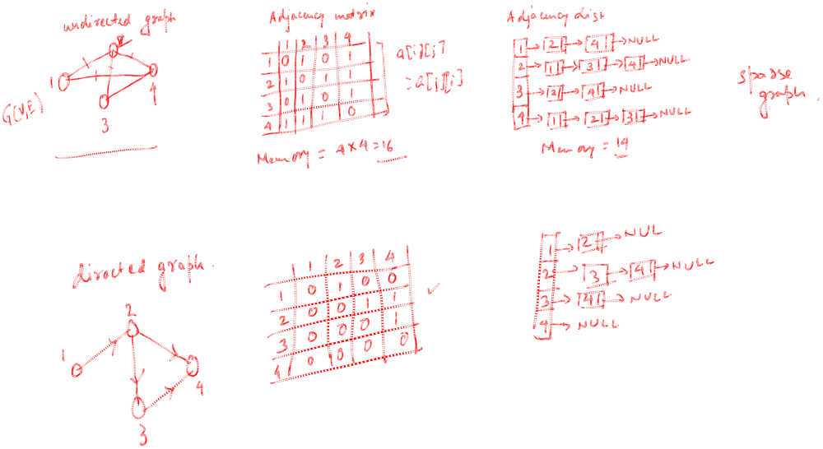

Example

Slide 10
Graph Traversal Techniques
There are two standard graph traversal techniques:
  Depth-First Search (DFS)
  Breadth-First Search (BFS)

Slide 11
Graph Traversal (Contd.)
In both DFS and BFS, the nodes of the undirected graph are visited in a systematic manner so that every node is visited exactly one.
Both BFS and DFS give rise to a tree:
  When a node x is visited, it is labeled as visited, and it is added to the tree
  If the traversal got to node x from node y, y is viewed as the parent of x, and x a child of y

Slide 12
Depth-First Search
DFS follows the following rules:
  Select an unvisited node x, visit it, and treat as the current node
  Find an unvisited neighbor of the current node, visit it, and make it the new current node;
  If the current node has no unvisited neighbors, backtrack to the its parent, and make that parent the new current node;
  Repeat steps 3 and 4 until no more nodes can be visited.
  If there are still unvisited nodes, repeat from step 1.

Slide 13
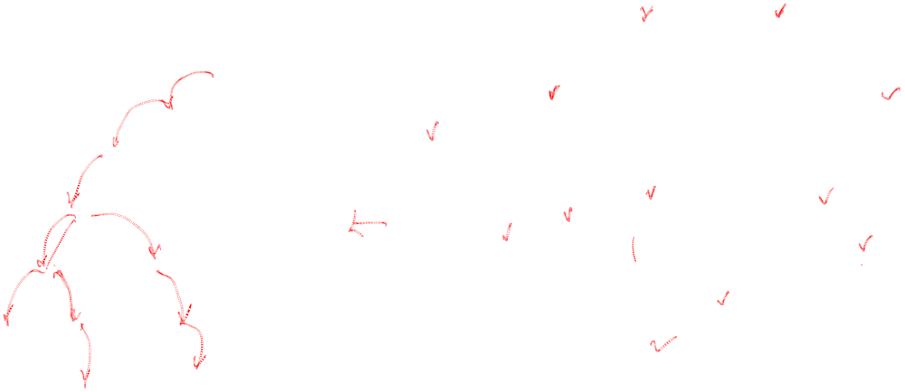
Example
0
1
0
2
1
4
4
9
10
5
7
2
11
8
5
9
6
7
11
6
Graph G
8
10
DFS Tree

Slide 14
DFS: Color Scheme
Vertices initially colored white
Then colored gray when discovered
Then black when finished

Slide 15

DFS: Algorithm
DFS(G)
for each vertex u in V,
color[u]=white;
π[u]=NIL
time=0;
for each vertex u in V
if (color[u]=white)
then DFS-VISIT(u)

Slide 16
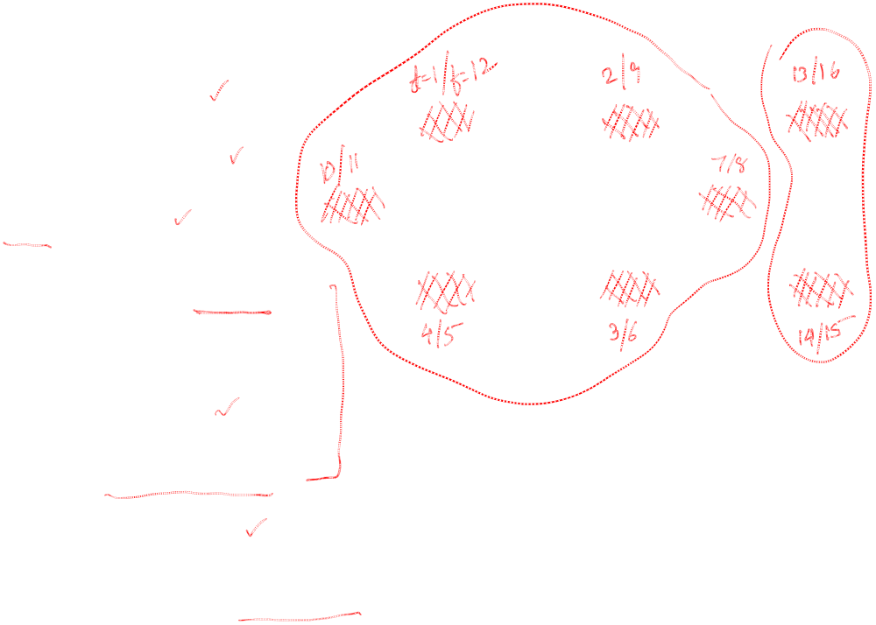
DFS: Algorithm (Cont.)
DFS-VISIT(u)
color[u]=gray;
time = time + 1;
d[u] = time;
for each v in Adj(u) do
if (color[v] = white)
π[v] = u;
DFS-VISIT(v);
color[u] = black;
time = time + 1; f[u]= time;
source
vertex

Slide 17
DFS: Complexity Analysis
Initialization complexity is O(V)
DFS_VISIT is called exactly once for each vertex
And DFS_VISIT scans all the edges which causes cost of O(E)
Overall complexity is O(V + E)

Slide 18
Breadth-First Search
BFS follows the following rules:
  Select an unvisited node x, visit it, have it be the root in a BFS tree being formed. Its level is called the current level.
  From each node z in the current level, in the order in which the level nodes were visited, visit all the unvisited neighbors of z. The newly visited nodes from this level form a new level that becomes the next current level.
  Repeat step 2 until no more nodes can be visited.
  If there are still unvisited nodes, repeat from Step 1.

Slide 19
Observations:
  the first node visited in each level is the first node from which to proceed to visit new nodes.
This suggests that a queue is the proper data structure to remember the order of the steps.

Slide 20
BFS: the Color Scheme
White vertices have not been discovered
  All vertices start out white
Grey vertices are discovered but not fully explored
  They may be adjacent to white vertices
Black vertices are discovered and fully explored
  They are adjacent only to black and gray vertices
Explore vertices by scanning adjacency list of grey vertices

Slide 21
An Example
A
B
C
D
E
F
G
H
I
J
K
L
M
N
O
P

Slide 22
A
B
C
D
0
E
F
G
H
I
J
K
L
M
N
O
P

Slide 23
A
B
C
D
0
1
E
F
1
G
H
1
I
J
K
L
M
N
O
P

Slide 24
A
B
C
D
0
1
2
E
F
1
G
H
1
2
I
J
K
L
M
N
O
P

Slide 25
A
B
C
D
0
3
1
2
E
F
1
G
H
1
3
3
2
I
J
K
L
M
N
O
P
3
3

Slide 26
A
B
C
D
0
3
1
2
E
F
1
G
H
1
3
4
3
2
I
J
K
4
L
4
M
N
O
P
3
3

Slide 27
A
B
C
D
0
3
1
2
E
F
1
G
H
1
3
4
3
2
I
J
K
4
L
4
5
M
N
O
P
3
3
5

Slide 28
A
B
C
D
0
3
1
2
E
F
1
G
H
1
3
4
3
2
I
J
K
4
L
4
5
M
N
O
P
3
3
5

Slide 29
A
B
C
D
0
3
1
2
E
F
1
G
H
1
3
4
3
2
I
J
K
4
L
4
5
M
N
O
P
3
3
5

Slide 30
BFS: Algorithm
BFS(G, s)
For each vertex u in V – {s},
  color[u] = white;
  d[u] = infinity;
  p[u] = NIL
color[s] = GRAY; d[s] = 0; p[s] = NIL; Q = empty queue
ENQUEUE(Q,s)
while (Q not empty)
u = DEQUEUE(Q)
for each v ∈ Adj[u]
if color[v] = WHITE
then color[v] = GREY
d[v] = d[u] + 1; p[v] = u
ENQUEUE(Q, v);
color[u] = BLACK;

Slide 31
BFS: Complexity Analysis
Queuing time is O(V) and scanning all edges requires O(E)
Overhead for initialization is O (V)
So, total running time is O(V+E)

Slide 32
Thank you

